Slide 1
School Run Organizer Webinar
Terry Fox School Run 2023

Slide 2
Fundraising Flow
A quick overview of how your fundraising supports cancer research!
School Run Toolkits
The tools we offer to help make your Run a success!
Setting a Goal
Give your students a goal to run towards!
Online Fundraising
Putting your Fundraising Link into action!
Promoting Your Run
On your mark... Get set... Go pump up your students for Run Day!
Terry T-Shirts & Try Like Terry Challenge
Additional resources and tips for having fun while fundraising!
School Run Day!
Happy Terry Fox School Run Day!
Post Run Day
Wrapping up another successsful campaign year!

Slide 3
Fundraising Flow
Thanks to support from schools like yours, The Terry Fox Foundation and Terry Fox Research Institute have become leaders in cancer research. Here's how your fundraising efforts support research projects, researchers, and cancer patients across Canada!
Administrative Costs
School Run, Community Run, Special Events
Research Projects into 200+ types of cancer
The Terry Fox Foundation has long prided itself on our low administrative costs compared to the industry standard, which is possible thanks to our ratio of approximately
1 employee for every 400 volunteers.
Monthly Donors, Major Gifts, Legacy Giving
Hundreds of Cancer Researchers across Canada
General Giving, Investments, Grants
Long-term Investments (i.e.; MOHCCN)
For more information on the research your efforts support, please visit www.TFRI.ca

Slide 4
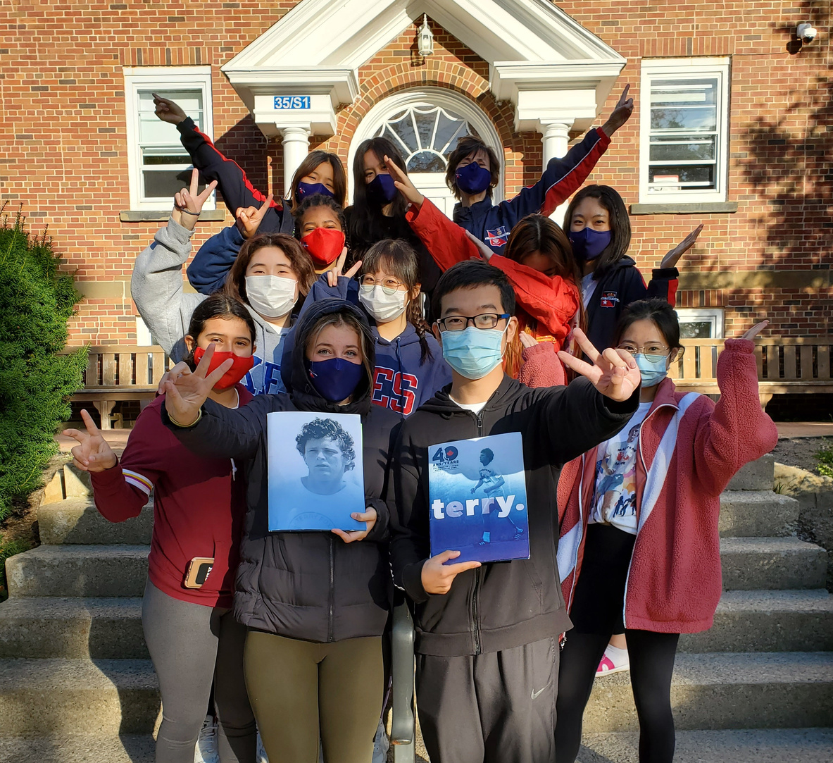
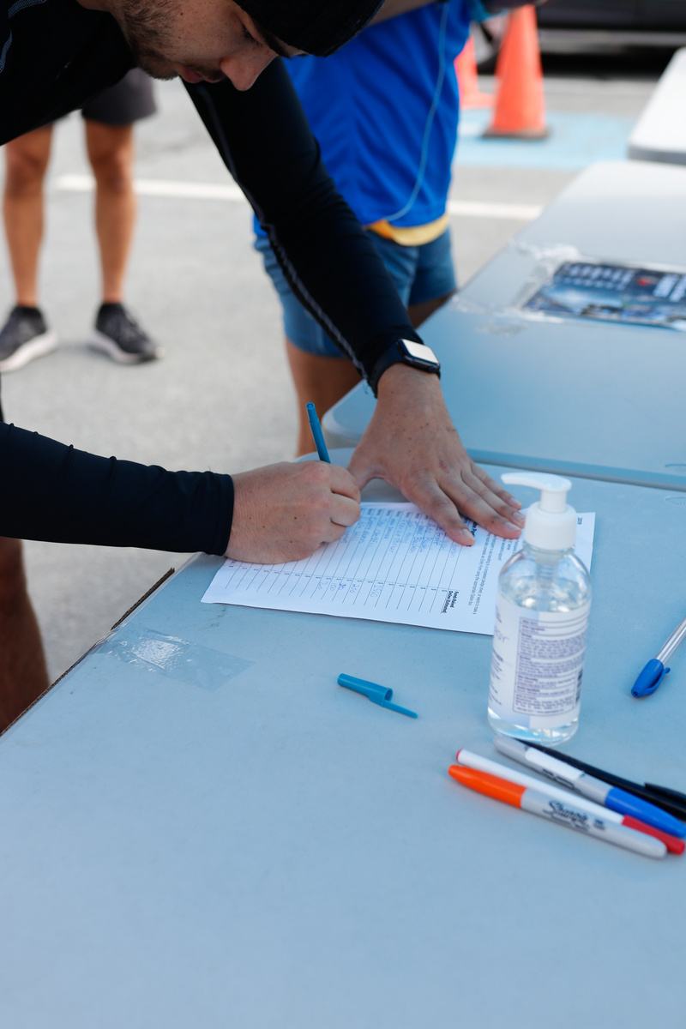
Toolkit
A complimentary Toolkit of materials will be sent to your school to support your event!
INSIDE YOUR TOOLKIT FOLDER:
"Dear Terry" Activity
Welcome Letter
Fundraising Tips
Merchandise Info + Forms
Student Take-Home Order Forms
Teacher Tracking Form
Pledge Sheet
Post-Run Report
Questions? Call our Toll Free Number anytime:
1-888-TFOXRUN
(1-888-836-9786)

Slide 5
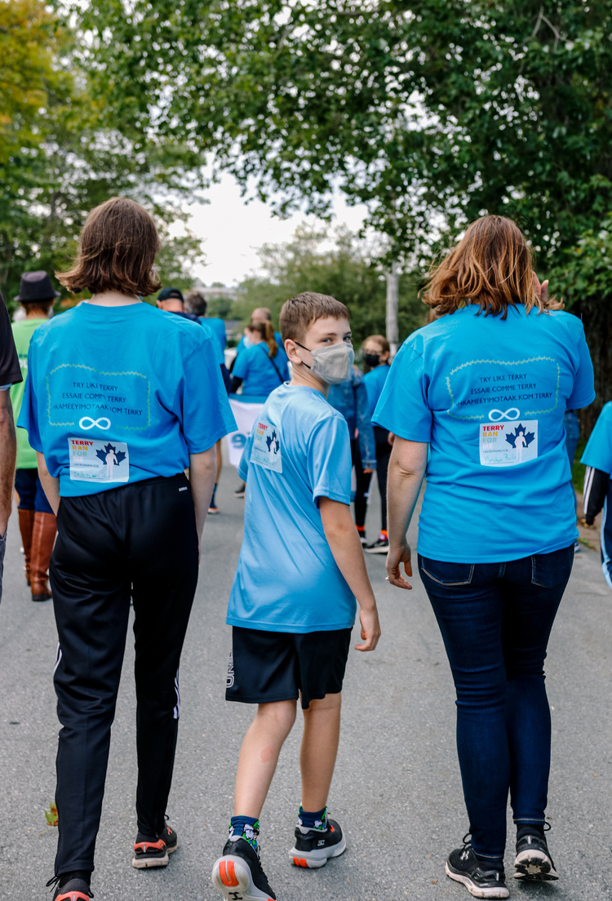
Toolkit
A complimentary Toolkit of materials will be sent to your school to support your event!
If your kit has not arrived yet, please contact your Provincial Office.
PROMOTIONAL MATERIALS:
Complimentary 2023 T-Shirt
Optional: Terry's Team Member Shirts
Poster Set
Goal Poster
"I am Running For..." Stickers
Tattoos
PLEDGE SHEETS
Pledge sheets are a great way to help with fundraising! Students are encouraged to ask adults in their life to support their fundraising efforts.

Slide 6
Ready... Set... Goal!
1
2
3
Pick Your
Run Date(s)
Set a Goal
Start Your Campaign!
Terry loved setting goals for himself, both in school and in the athletic arena.
Your students will, too!
Set a Fundraising Goal
to motivate students as
Run Day approaches!
It's time to plan for your Terry Fox Run!
You're ready to begin! Launch your fundraising efforts and ask students for support.
Terry Fox School Run Day is
Friday, September 22nd
or any day that works for your school!
GET STUDENT LEADERS INVOLVED:
PLAN AHEAD FOR:
Use the Student Leadership Guide to plan your campaign
Gather your Run Committee
Assign tasks to Leaders
Virtual Presentations
Post Run Day Celebrations
Ordering T-Shirts
Visits from In-Person Terry Fox Foundation Representatives
YOUR GOAL SHOULD BE:
Challenging
Achievable
Exciting

Slide 7
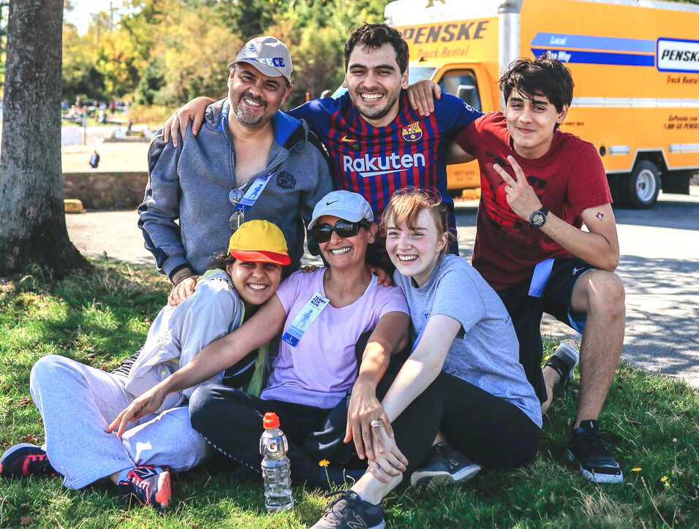
Student Leadership
Enlist the help of student leaders to organize your event, broaden student social awareness, and encourage new young future leaders. With their help, you’ll reach your fundraising goal in no time!
ELEMENTARY STUDENT “BE LIKE TERRY” LEADERSHIP GUIDE
A fun guide filled with fundraising tips, inspiration and resources for elementary students!
HiGH SCHOOL EVENT PLANNING GUIDE
A structured event planning guide to help students collect volunteer hours and take ownership of their school event.
STUDENT LEADERSHIP RESOURCES ARE JUST A CLICK AWAY!
VISIT WWW.TERRYFOXSCHOOLRUN.ORG TO LEARN MORE!

Slide 8
Online Fundraising
BENEFITS OF ONLINE FUNDRAISING
Supporters receive their tax receipt via email immediately after donating
Allows fundraisers to reach more people in their network
Lower administrative costs and environmental impact
YOUR SCHOOL FUNDRAISING LINK
Open your school fundraising link
OR search for your school on our website!
Share your school fundraising link with your students, staff, and school community!
Want to go the extra mile? Log in to personalize the page with photos and more!

Slide 9
Online Fundraising
SETTING UP INDIVIDUAL FUNDRAISING PAGES
Encourage students to earn Badges as they reach fundraising milestones
Empower students to develop an interest and understanding of philanthropic efforts
Helps reach a wider network than school-focused fundraising
STUDENT/CLASSROOM LINKS
Open your school fundraising link
OR search for your school on our website!
Accept the waiver and fill out registration form
Share your personal fundraising link with friends and family!
Individual fundraising pages contribute directly to your school's overall Online Fundraising!

Slide 10
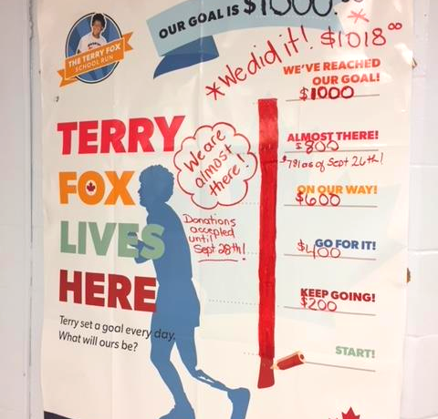
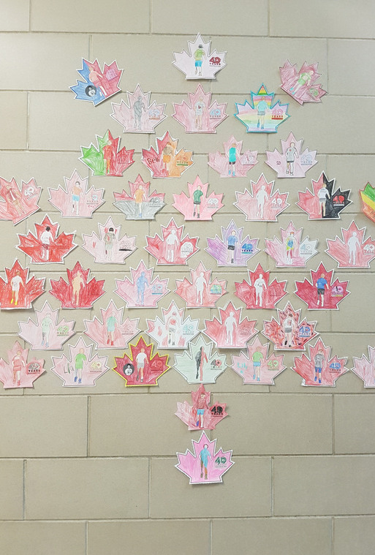
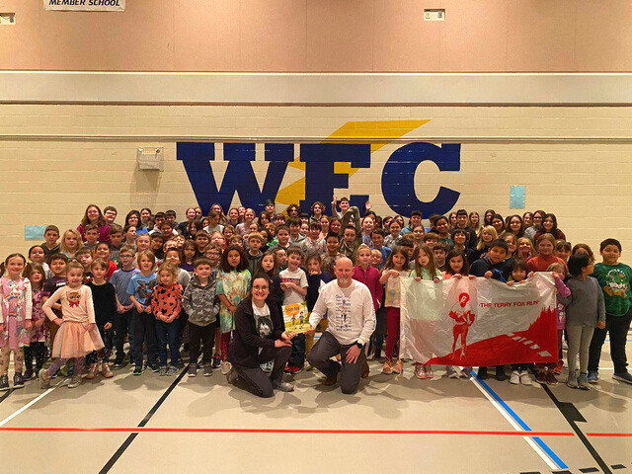
Promoting Your Run
Build excitement for your Run!
Posters and Student-Made Decorations
Virtual Meet-Ups With Fred Fox
T-Shirt Sales
Educator Resources
Virtual Classroom
Lesson Plans
Morning Announcements
... And More!
find all of our resources at www.terryfoxschoolrun.org

Slide 11
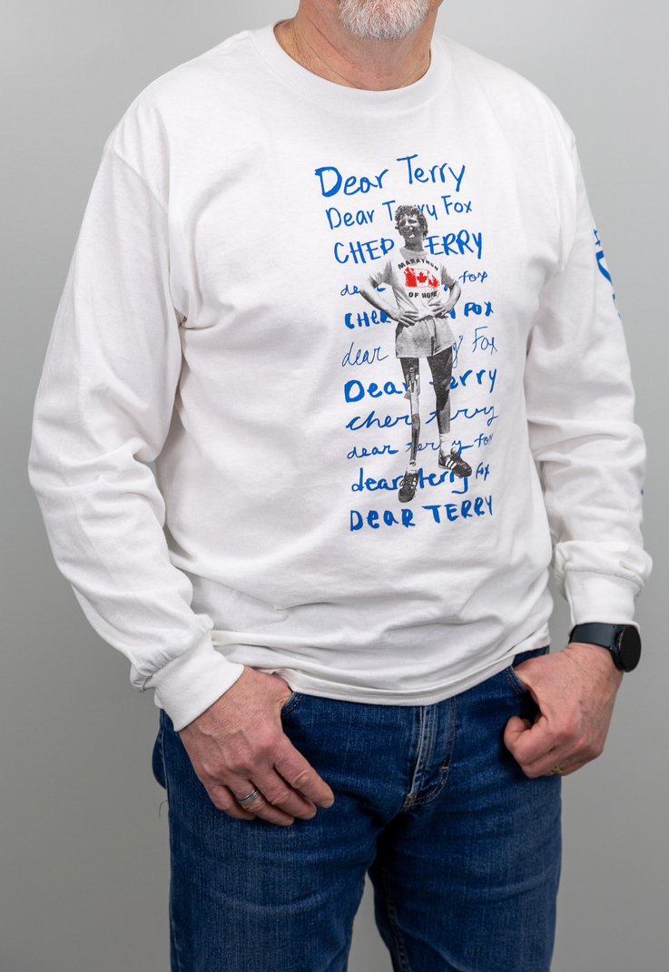
Terry T-Shirts
ORDERING T-SHIRTS
T-SHIRT TIPS
Student Order Form
Online Merchandise Order Form
Shirts are available in sizes 6X - 2XL
Set a deadline for placing orders
All T-Shirt sales are final
All T-Shirt sales contribute to your school fundraising total
2023 LIMITED EDITION T-SHIRTS
The 2023 Terry Fox Run shirt design was designed together with input from Ryan Reynolds and the Fox Family. The shirt features messages Terry and his family received both past and present, and celebrates how his story and legacy continues to inspire people of all ages, backgrounds, and abilities in Canada and beyond.
(All sales are added to your school’s fundraising total.)
TERRY'S TEAM MEMBER T-SHIRTS
A Terry’s Team Member is someone who has had a personal diagnosis of cancer and is at any stage of their treatment or recovery. The Terry Fox Foundation honours these individuals with a special red Terry’s Team Member t-shirt recognizing the wearer as a cancer survivor.
Terry's Team Member Shirts are available for students and staff in your school community.

Slide 12
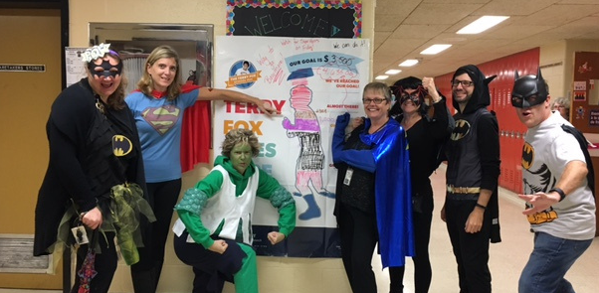
Terry Fox Challenges
Plan a fun and exciting challenge to incentivize your students as they fundraise!
Creating Your Challenge
Plan for an individual, classroom, OR school-wide Challenge
Encourage students to get creative with their Challenge ideas
Set clear Challenge guidelines
Offer incentives, like extra recess or a pizza party!
Consider using resources like your Goal Poster to track your Challenge!
Challenge Ideas
Ask students to try for a personal best or to commit to trying something new
How many KMs can our school walk before Run Day?
Ask each grade level to create a Challenge within their grade level
Incentivize students with the promise of Staff in silly outfits
Create a Challenge board where students can track progress
"ANYTHING IS POSSIBLE IF YOU TRY."
TERRY FOX

Slide 13
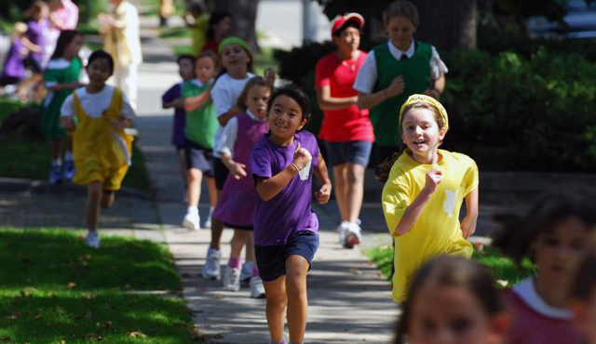
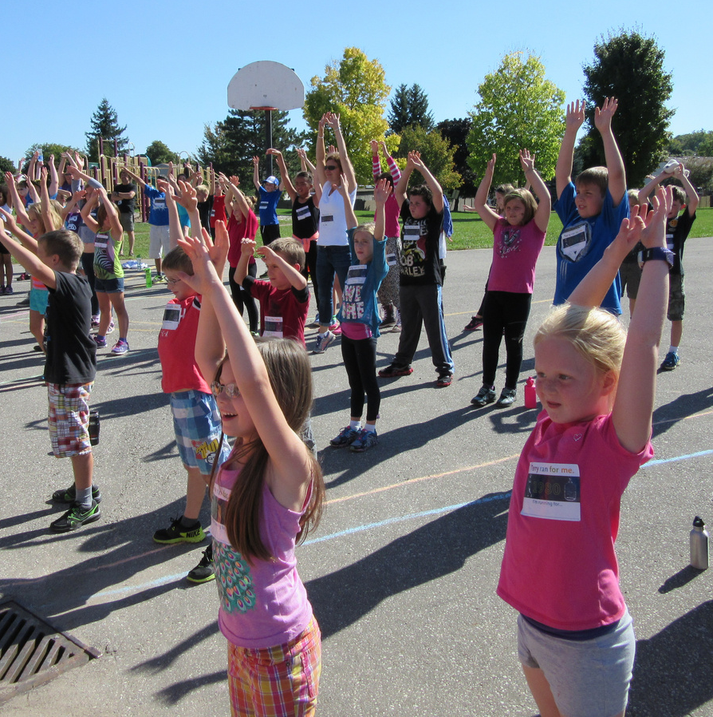
Terry Fox Run Day
It's Run Day! Take your Run the extra mile.
Host a virtual or in-person assembly
Plan a run route and decorate it
Play some cool tunes
Kick off Run Day with a warm-up video
Run Day Safety
Encourage students to bring water and snacks
Remind students to dress for the weather
Confirm any volunteers ahead of time
Review sidewalk safety tips if leaving school property
Multi-Day Events
Build excitement before Run Day with fun activities
Have students participate in cohorts over multiple days
Celebrate your Try Like Terry Challenge
Remind students of upcoming activities like virtual assemblies

Slide 14
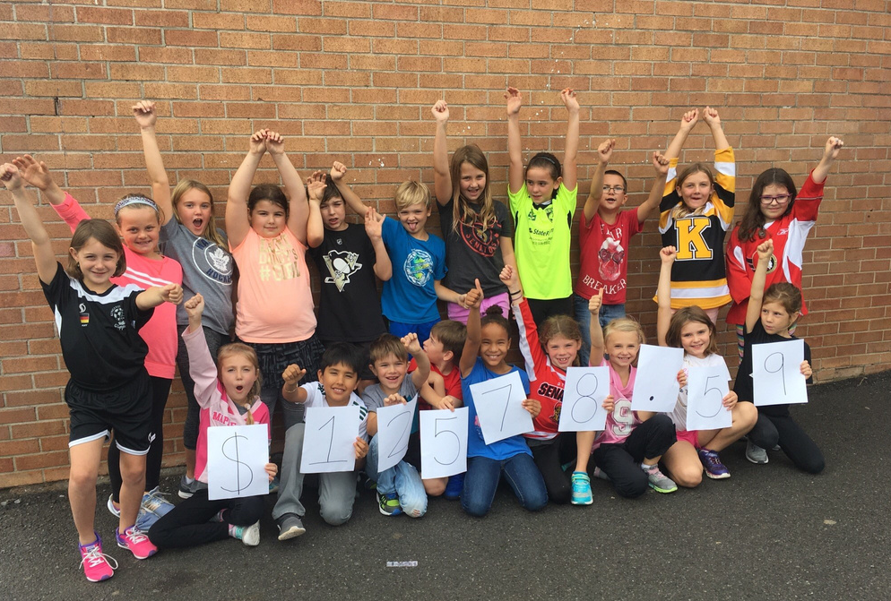
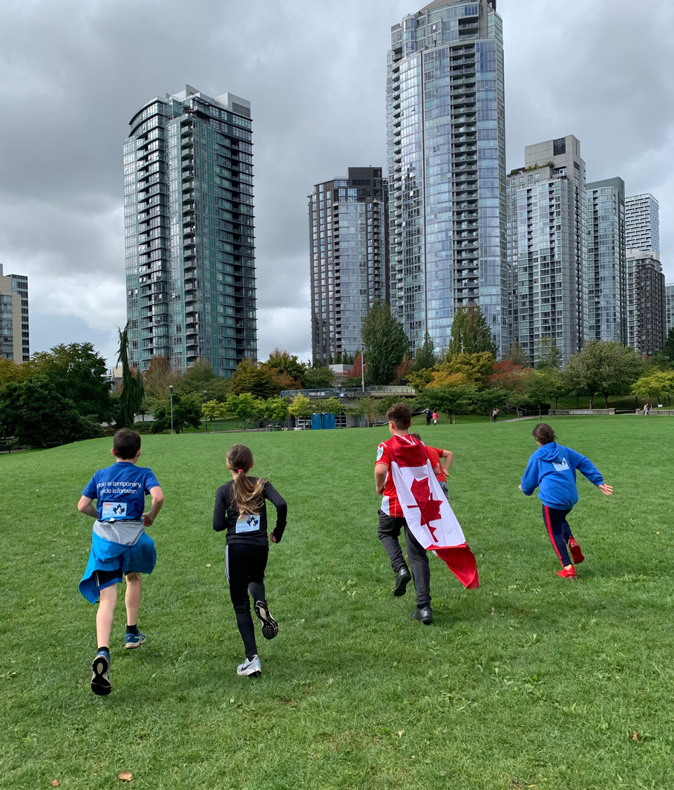
After Your Run
Celebrate Achievements
Share highlights from your Run Day with your school community
Celebrate fundraising achievements
Announce Terry Like Terry Challenge results and incentives
Wrap Up Your Run
Complete your Post-Event Report
Submit your funds
Notify your school community
Share Your Highlights
Our Foundation staff love seeing the highlights from your events!
After Run Day, please send your photos and stories to your Provincial School Development Officer. Your school may even be featured in future School Run promotions!

Slide 15
Thanks for joining us!
Questions?

